Slide 1

FreeBee
Cross-technology Communication via Free Side-channel
Song Min Kim and Tian He
Computer Science and Engineering
University of Minnesota

Slide 2

Outline
Background and Motivation
FreeBee Design
  System Implementation & Evaluation

Slide 3
Outline
Background and Motivation
FreeBee Design
  System Implementation & Evaluation

Slide 4

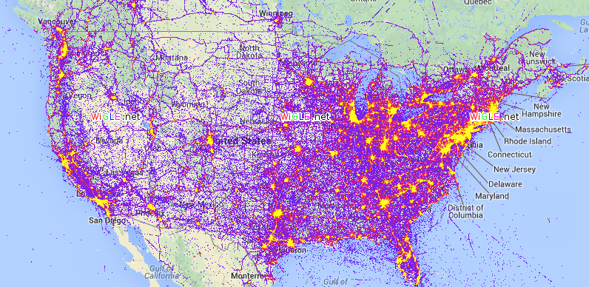
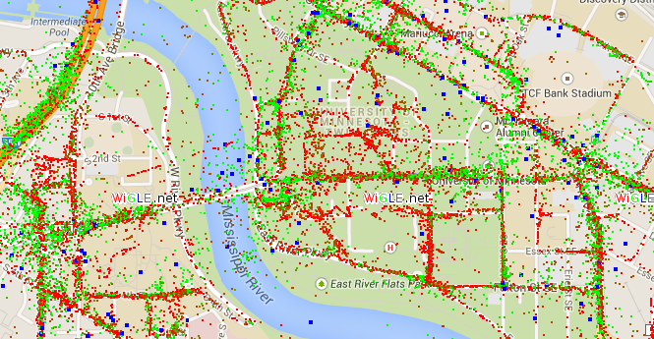
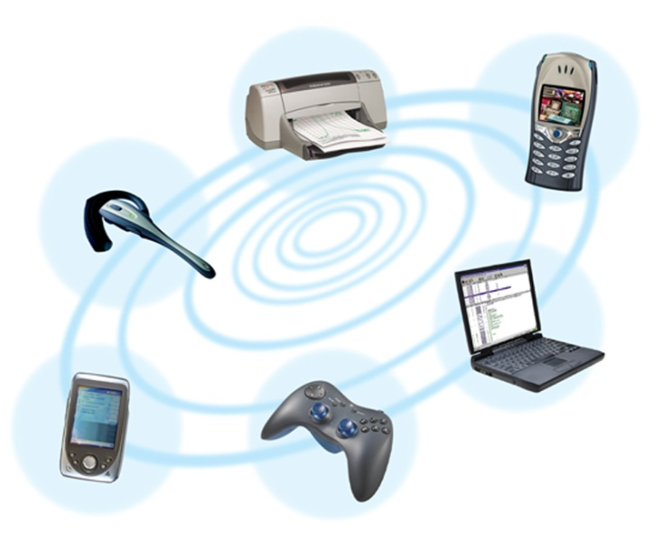


Wireless is everywhere
<wigle.net>

Slide 5
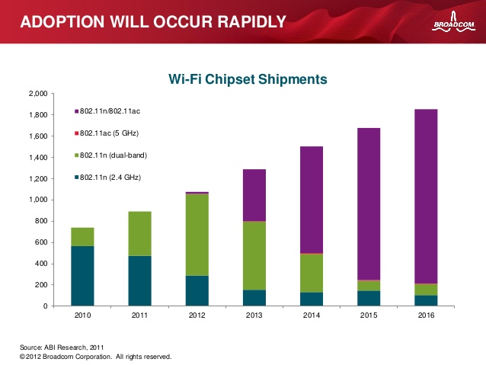
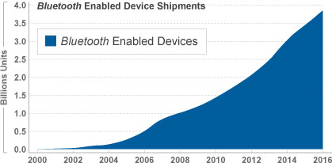
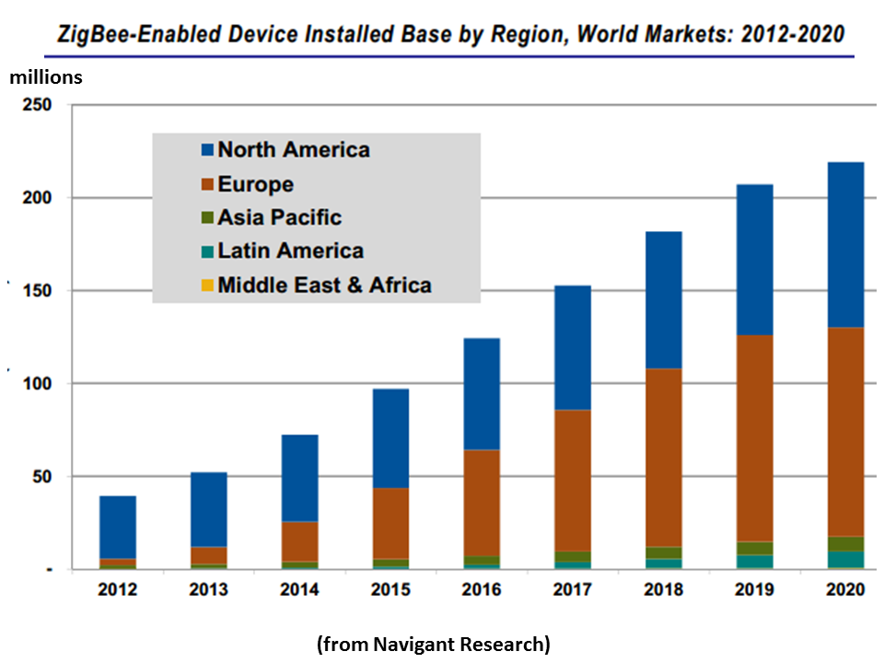

… and is only becoming denser
~3B
1.5B
Source: ABI Research
~70M
Source: Navigant Research

Slide 6


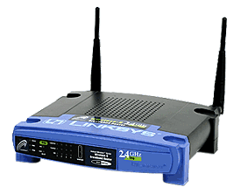


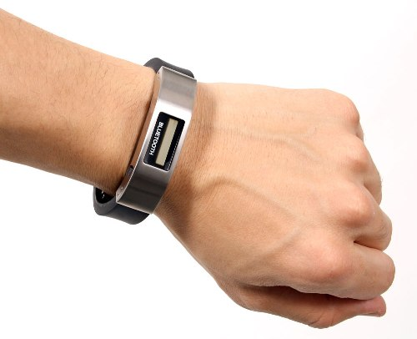

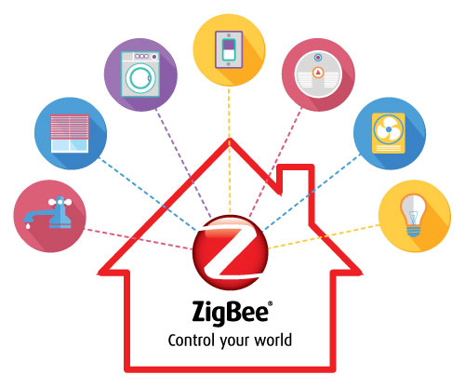

Issue & opportunity
Dark side
  Cross-interference due to incompatible PHY/MAC
Bright side
  New application via information sharing
Address issue &
Explore opportunity
via comm. between tech.
Location
Internet
collision
Personal Health Information
Environmental
Monitoring
Information

Slide 7
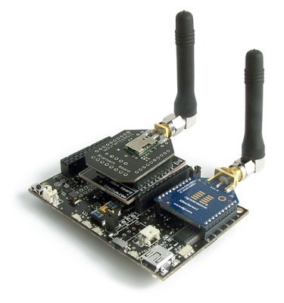
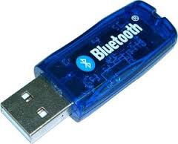
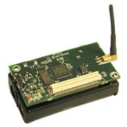
Is there an existing solution?
Traditionally, technologies communicate via multi-radio gateways
FreeBee allows coexisting wireless technologies to directly talk to each other
- Extra HW cost (> $150)
- Control traffic overhead
- Deployment complexity
FreeBee

Slide 8
For spectrum efficiency
A building block for explicit channel access coordination, reducing cross-technology interference
  Extends local mechanisms globally across wireless tech.
    Global Network Allocation Vector (NAV)
    Global RTS/CTS Reservation
    Global Time Division Multiple Access (TDMA)
No traffic
next 20ms
I need next 200ms
Time
WiFi
ZigBee
WiFi

Slide 9
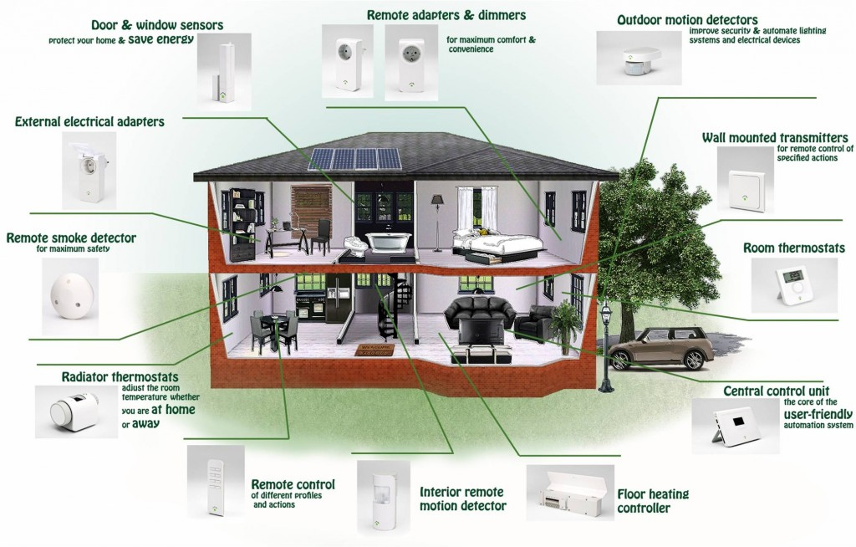


For cost efficiency
ZigBee smart home devices
Support for Smart Home
  Eliminates the need for the Gateway HW bridging WiFi and ZigBee technologies (>$150)
Smartphone not associated
Away Mode
Home Mode
Smartphone associated
WiFi AP

Slide 10
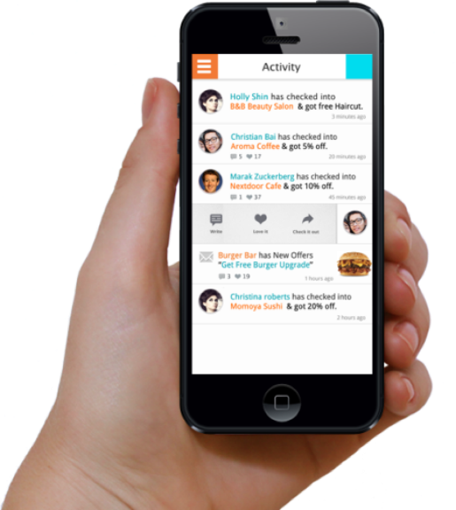

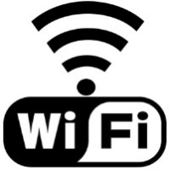


For energy efficiency
State-of-the-art Wake-on-WLAN (MobiCom `10)
Wake-on selective WLAN
  Keep WiFi interface OFF
  for private WiFi AP
  Wake WiFi interface ON
  only when OPEN AP nearby
It is waste of energy to wake up for inaccessible private WiFi APs.
Can we improve this?
ZigBee module in SD card
(Spectec Computer Co., Ltd)
Serves as the secondary radio
WiFi interface is turned off
Wakes up WiFi interface when it detects any WiFi AP in proximity
OFF
ON
However, urban areas are usually overfilled with WiFi APs, where they are MOSTLY PRIVATE (Secured)
Free (open)
WiFi AP
Private
WiFi AP
OFF
ON

Slide 11
Outline
Background and Motivation
FreeBee Design
  System Implementation & Evaluation

Slide 12

FreeBee in a nutshell
Operational Requirement
  Sender: Support beacon operations
  Receiver: A wireless RF chip for RSS sampling
  Frequency (partial) overlap
?
Supported
Supported
Supported
Provisional patent filed

Slide 13
Key features of FreeBee
Technology Independent: WiFi, ZigBee, Bluetooth, etc
Free & Transparent: establishes side-channel with mandatory beacons. No impact to the legacy traffic.
Easy to Deploy: no HW/PHY modification.
For Control : mainly for delivering control information.
  Up to 1.4Kbps throughput (more on this later)
  Broadcast via beacon for receivers to listen on-demand, supporting mobile and/or duty-cycled receivers

Slide 14
FreeBee architecture
FreeBee design
(All software)
ZZZZZ
FreeBee Multiple Access
FreeBee Multiple Access
FreeBee Modulator
FreeBee Demodulator
IEEE Standard MAC/PHY
IEEE Standard RSS Sampler
Tx
Commodity HW
Rx

Slide 15
FreeBee architecture: PHY
FreeBee Multiple Access
FreeBee Multiple Access
FreeBee Modulator
FreeBee Demodulator
IEEE Standard MAC/PHY
IEEE Standard RSS Sampler
Tx
Rx

Slide 16
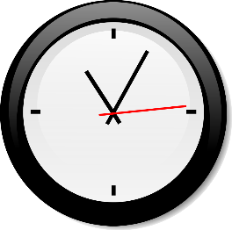
S-FreeBee: modulation
t-T/2
t-2Δ
t-Δ
t+Δ
t+2Δ
t+T/2
t
(reference position)
time
Initially beacons are transmitted at the reference position
  Let receiver ‘learn’ the position
Shift beacons between (-T/2, T/2] from the reference position to embed S-FreeBee symbol.
  T is beacon interval
  Let Δ is the unit of shift, then
One S-FreeBee symbol is worth log2(T/Δ) bits
Requires time sync to keep track
of the reference position
Not suitable for mobile environment?

Slide 17
A-FreeBee: modulation
Beacons shifted by -Δ
t+(T- Δ)
t+(3T- Δ)
t+(5T- Δ)
t
t+2T
t+4T
time
Shift every other beacons, between (-T/2, T/2]
Use the distance between two consecutive beacons to convey a symbol (instead of shift offset in S-Freebee)
Lower symbol rate, but no learning needed.

Slide 18
FreeBee Architecture: PHY
FreeBee Multiple Access
FreeBee Multiple Access
FreeBee Modulator
FreeBee Demodulator
IEEE Standard MAC/PHY
IEEE Standard RSS Sampler
Tx
Rx

Slide 19
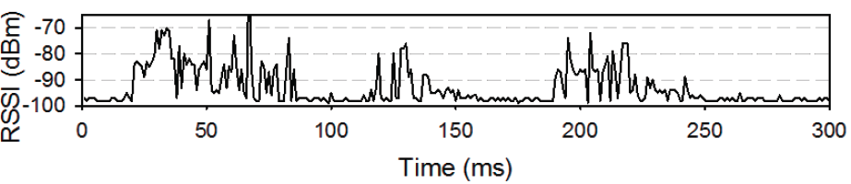
FreeBee demodulation
Challenge: receiver can only sense RSS, no decoding possible (due to incompatible PHY)
Idea: We utilize the periodicity of beacons, as others are most likely not periodic
  Receiver demodulate statistically.
Hidden Beacons
RSS Samples under Cross Technology Interference

Slide 20
Beacon detection solution
Receiver samples RSS continuously
(This is by default in standards; e.g. ZigBee (802.15.4))
Samples are quantized (0 or 1) according to threshold.
Digital signal processing of Folding* is utilized to statistically determine the position of beacons
Fold by the interval (=4)
Non-periodic signals
spread out
-95
-70
-87
92
-56
-68
-90
-91
-59
-69
-87
-55
Beacons with interval of 4
Threshold = -75 dBm
Fold sum: 2 3 0 1
0
1
0
0
1
1
0
0
1
1
0
1
Column with the peak value
indicate beacon position
Non-periodic data packets/noise
*David H. Staelin, “Fast folding algorithm for detection of periodic pulse trains”, Proceedings of The IEEE -PIEEE, 1969

Slide 21
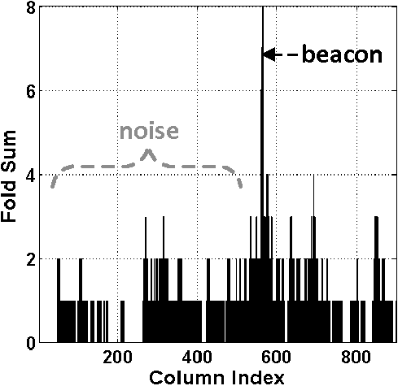
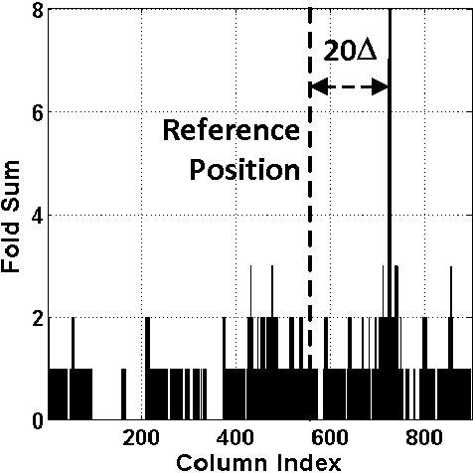
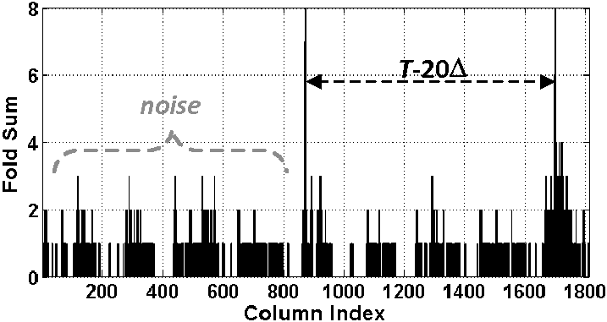
Detection in practice
Reference
Position
Offset=symbol
S-FreeBee (Fold by T)
with Time sync
A-FreeBee is more practical,
(time sync not required)
but is slower than S-FreeBee
A-FreeBee (Fold by 2T)
Without Time Sync
Distance=symbol

Slide 22
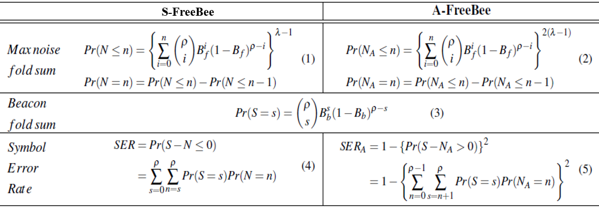
Analytics on symbol error rate
  Factors affecting Symbol Error Rate (SER)
  ρ: The number of beacons captured in RSS samples
  T: beacon interval
  Sampling duration: time to obtain one symbol (=ρT)
  B: Channel busy ratio (=ratio of 1’s in RSS samples)
T =4
Sampling duration= ρT=16Δ
B =9/16
Beacons with interval of 4
0
1
0
0
ρ =3
1
1
0
0
ρ =4
1
1
0
1
0
1
0
0
1
1
0
0
1
1
0
1
Fold sum: 2 3 0 1
0
1
1
1
Fold sum: 2 4 1 1
Non-periodic data packets (noise)
SER derivation in paper
Controls tradeoff: bit rate Vs. reliability

Slide 23
FreeBee architecture: MAC
FreeBee Multiple Access
FreeBee Multiple Access
FreeBee Modulator
FreeBee Demodulator
IEEE Standard MAC/PHY
IEEE Standard RSS Sampler
Tx
Rx

Slide 24
FreeBee MAC: interval multiplexing
Many to one
Many to many
We term this new scheme as ‘interval multiplexing’
  As it is achieved by selecting appropriate beacon intervals (T) to ensure orthogonal channels

Slide 25

Interval multiplexing: example
TX₁
T₁=3
Fold by 3
1
0
1
RX
1
0
0
1
0
0
1
0
0
1
0
0
1
1
0
Holds for arbitrary number of signals
when they are pairwise co-primes
(Details in paper)
+
1
0
1
1
0
0
1
1
0
Detected!
TX₂
T₂=5
Merged signal
0
0
1
0
0
0
0
1
0
1
0
1
1
0
Fold by 5
0
1
1
0
1
RSS noise from APs of non-interest are evenly distributed throughout the columns, which prevent RSS noise from forming a high fold sum.

Slide 26
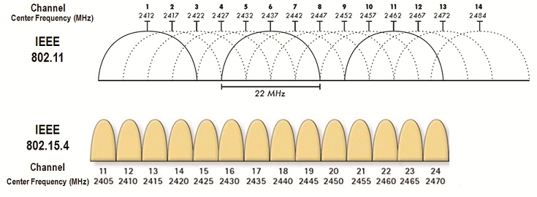
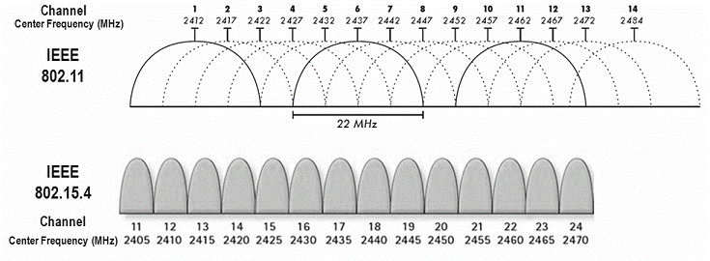
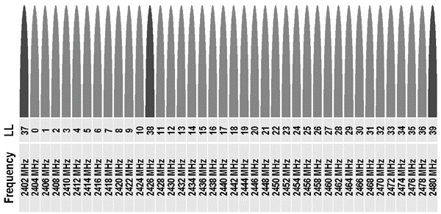
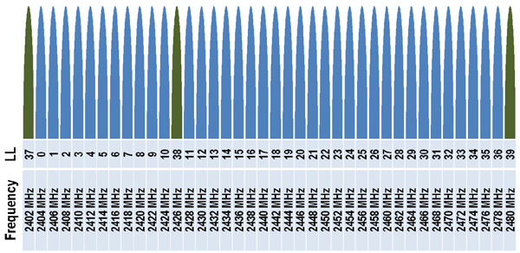
Cross-tech/channel broadcast
FreeBee ensures communication when frequency overlaps
Cross-technology broadcast
Cross-channel broadcast
Ch. 14
Ch. 15

Slide 27
Outline
Background and Motivation
FreeBee Design
  System Implementation & Evaluation

Slide 28
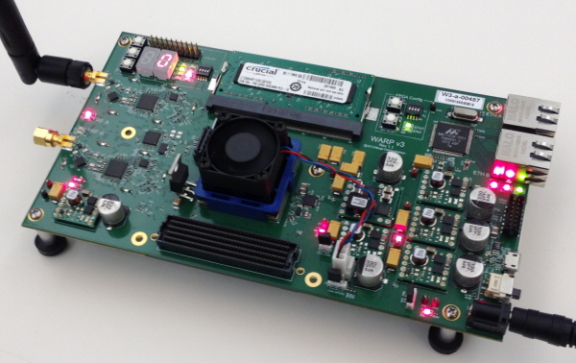
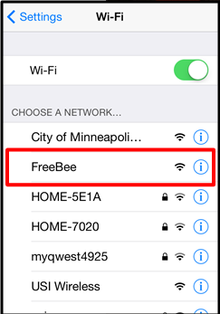
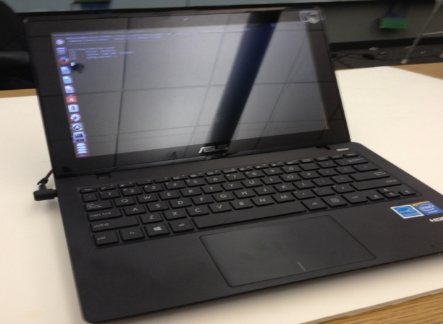
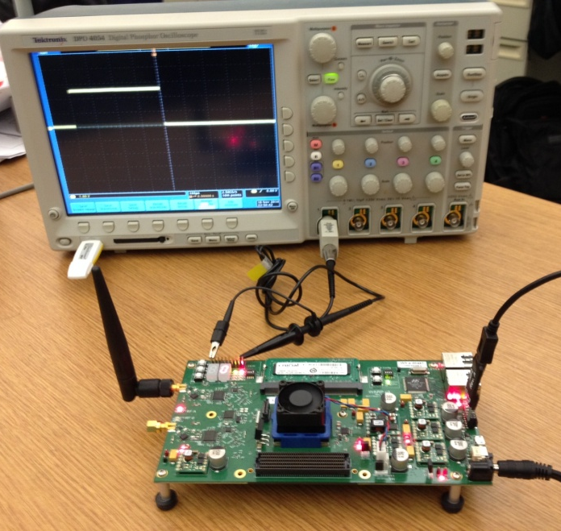
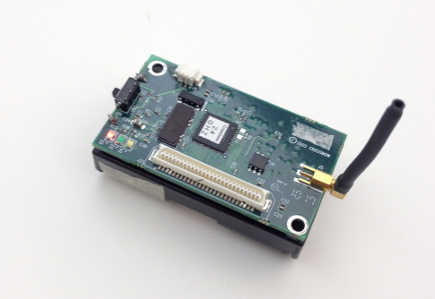
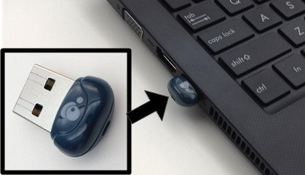
FreeBee prototype implementations
WARP v3
Laptop (ASUS K200MA)
MICAz
USB dongle (IOGEAR)

Slide 29
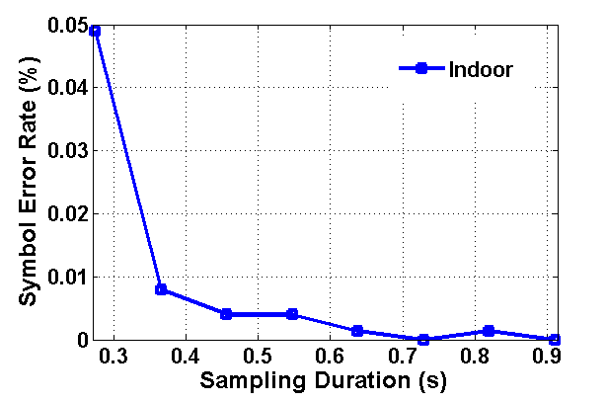
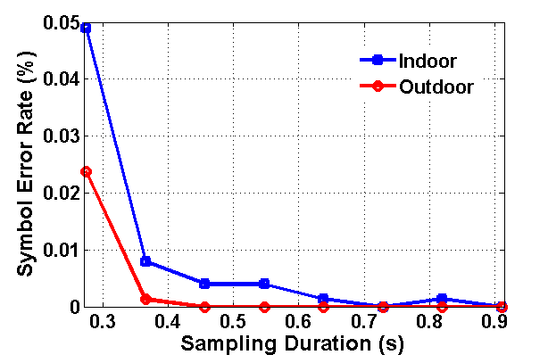
Symbol error rate
Performs better outside due to less noise
Reaches below 1% error at 360 ms under both scenarios
Or equivalently, when ρ = 4

Slide 30
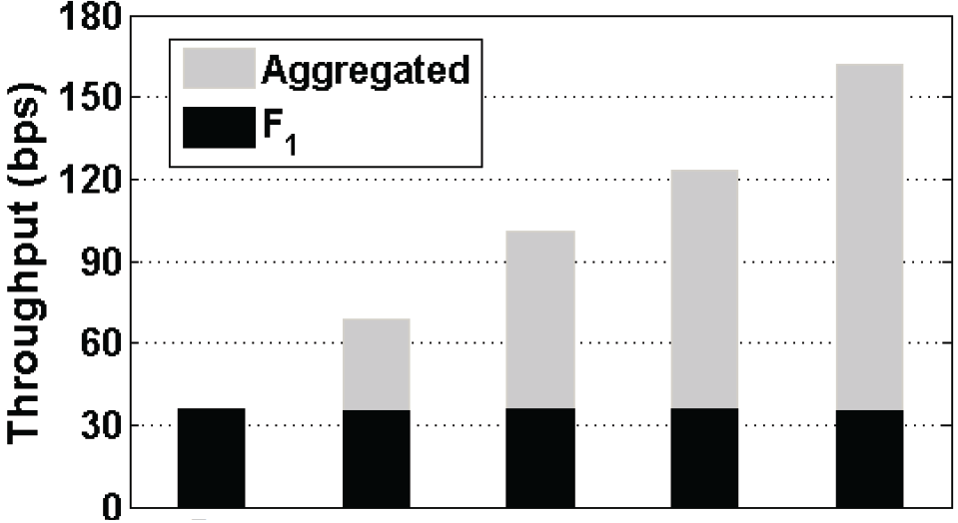
Interval multiplexing
To test noise between FreeBees
  Five APs, turn on FreeBee 1 by 1 every 10 minutes
FreeBee ON
Legacy AP
FreeBee ON
Legacy AP
FreeBee ON
Legacy AP
FreeBee ON
Legacy AP
FreeBee ON
Legacy AP
F₁
F₂
F₃
F₄
F₅
Aggregated
Effect of interval multiplexing
F₁
Negligible noise
between FreeBee signals
F₁
ON
F₁-F₂
ON
F₁-F₃
ON
F₁-F₄
ON
F₁-F₅
ON

Slide 31
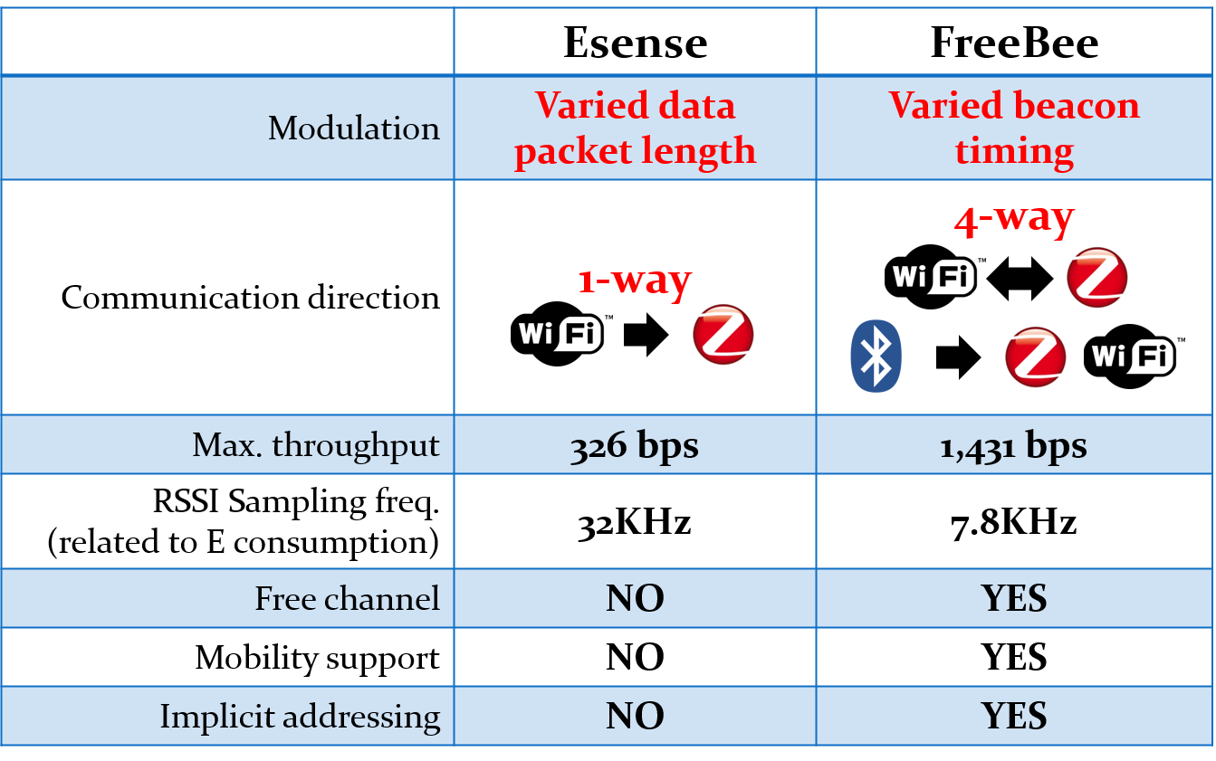
Max. aggregated throughput
S-FreeBee
A-FreeBee
Esense (MobiCom `09)
4.3 x
S-FreeBee folds with T
A-FreeBee folds with 2T
Throughput difference due to:
Sampling freq., unit shift duration (∆), and so on
(Please refer to paper for details)
> 4 x
< 1/4 x

Slide 32
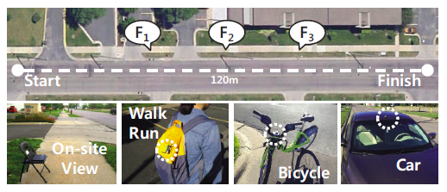
Mobile & duty-cycling
In a residential area
  Speeds: Walk (4.3 mph), Run(6.8), Bicycle(10.8), Car(30)
  Tested on three A-FreeBee senders
  Repeated 30 times for each speed

Slide 33
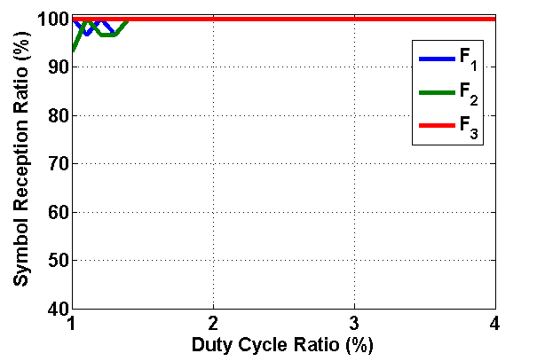
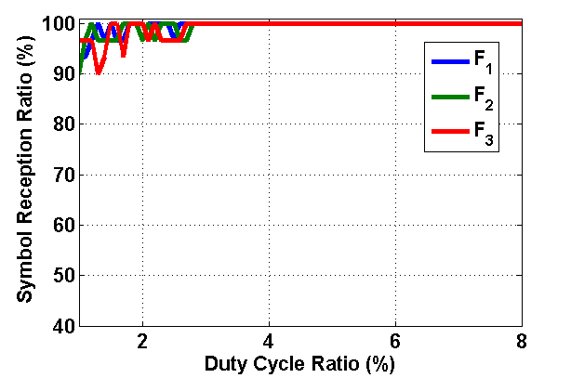
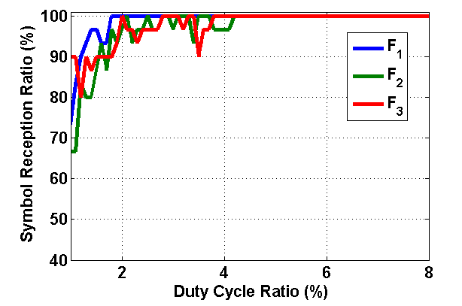
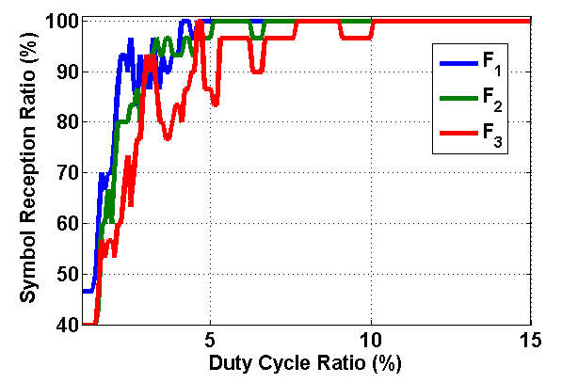
Mobile & duty-cycling
Reliable at: 1.5%
3%
Walk
Run
4.5%
10%
Bicycle
Car

Slide 34
Summary
Wireless coexistence brings challenges (e.g., interference) as well as opportunities (e.g., information sharing)
FreeBee enables coordination and sharing without the need for gateways
Free-side channel design in FreeBee does not impact legacy network traffic, while offering free-benefits.

Slide 35
Thank you!!
Questions?

